Slide 1

Presenting
From Order Takers to Rainmakers
Empowering Sales Through Smart Websites
Starring Timothy Howard
On the Cultivate Live! Stage; Sunday 4:30-5:00pm

Slide 2
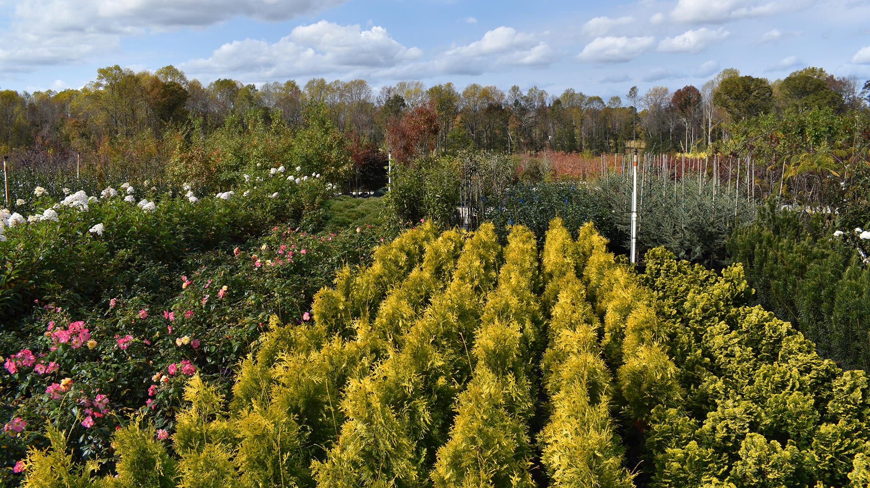
What tasks keep your sales team from developing your business and significantly increasing sales?

Slide 3
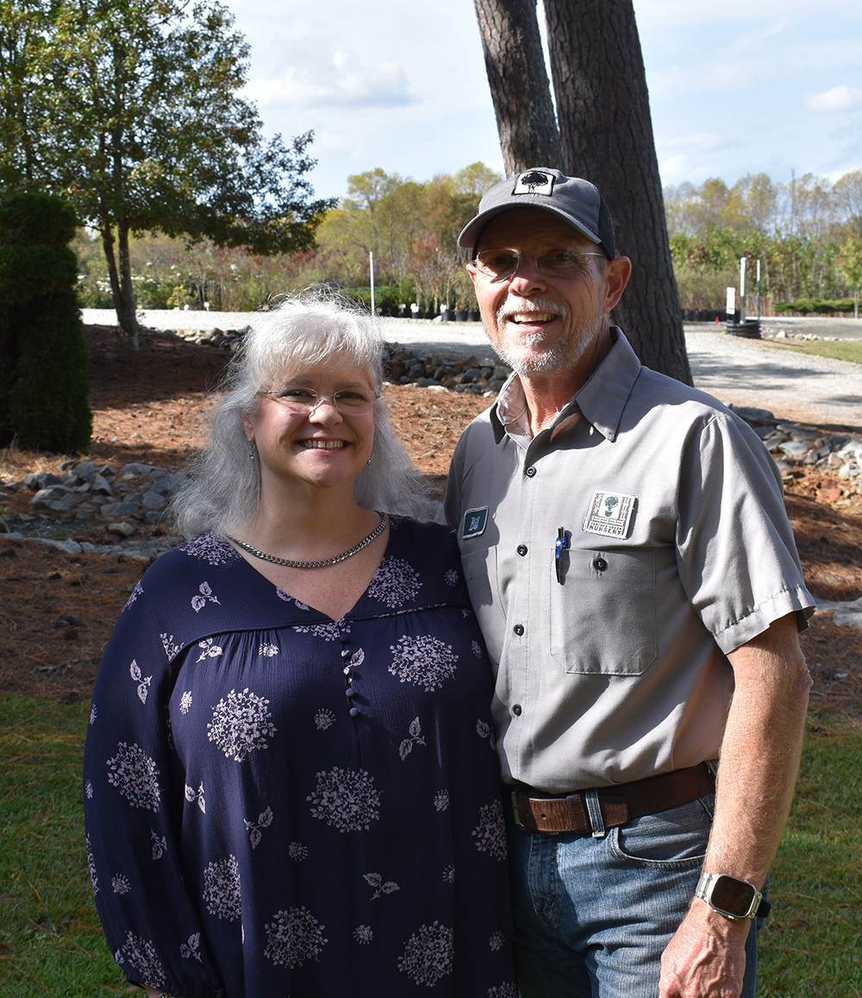
What our customers say:
Processing Current Crop Photo Requests
Addressing Orders with Oversold Plants
(and Recommending Substitute Plants)
Sending inventory updates;
Providing Customer Specific Price Lists
Emailing Marketing Images to Customers
Handholding New Buyers
Suggesting Companion Plants
Bill & Melissa Adams, Owners
Panther Creek Nurseries
Willow Spring, NC

Slide 4
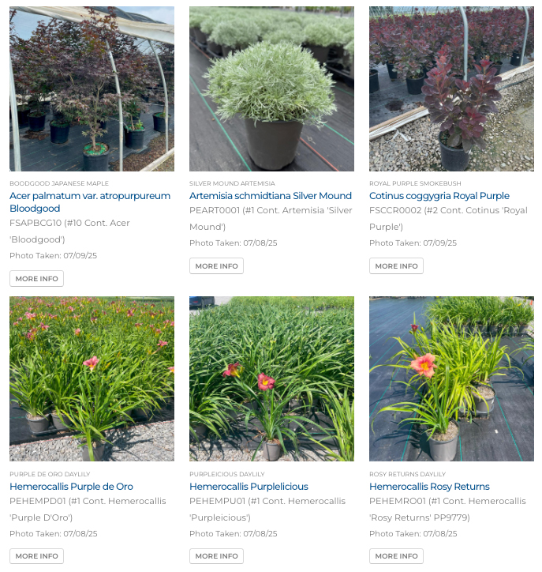
Simplifying Current Crop Photo Requests

Slide 5

Simplifying Current Crop Photo Requests
Have requests come through your website

Slide 6
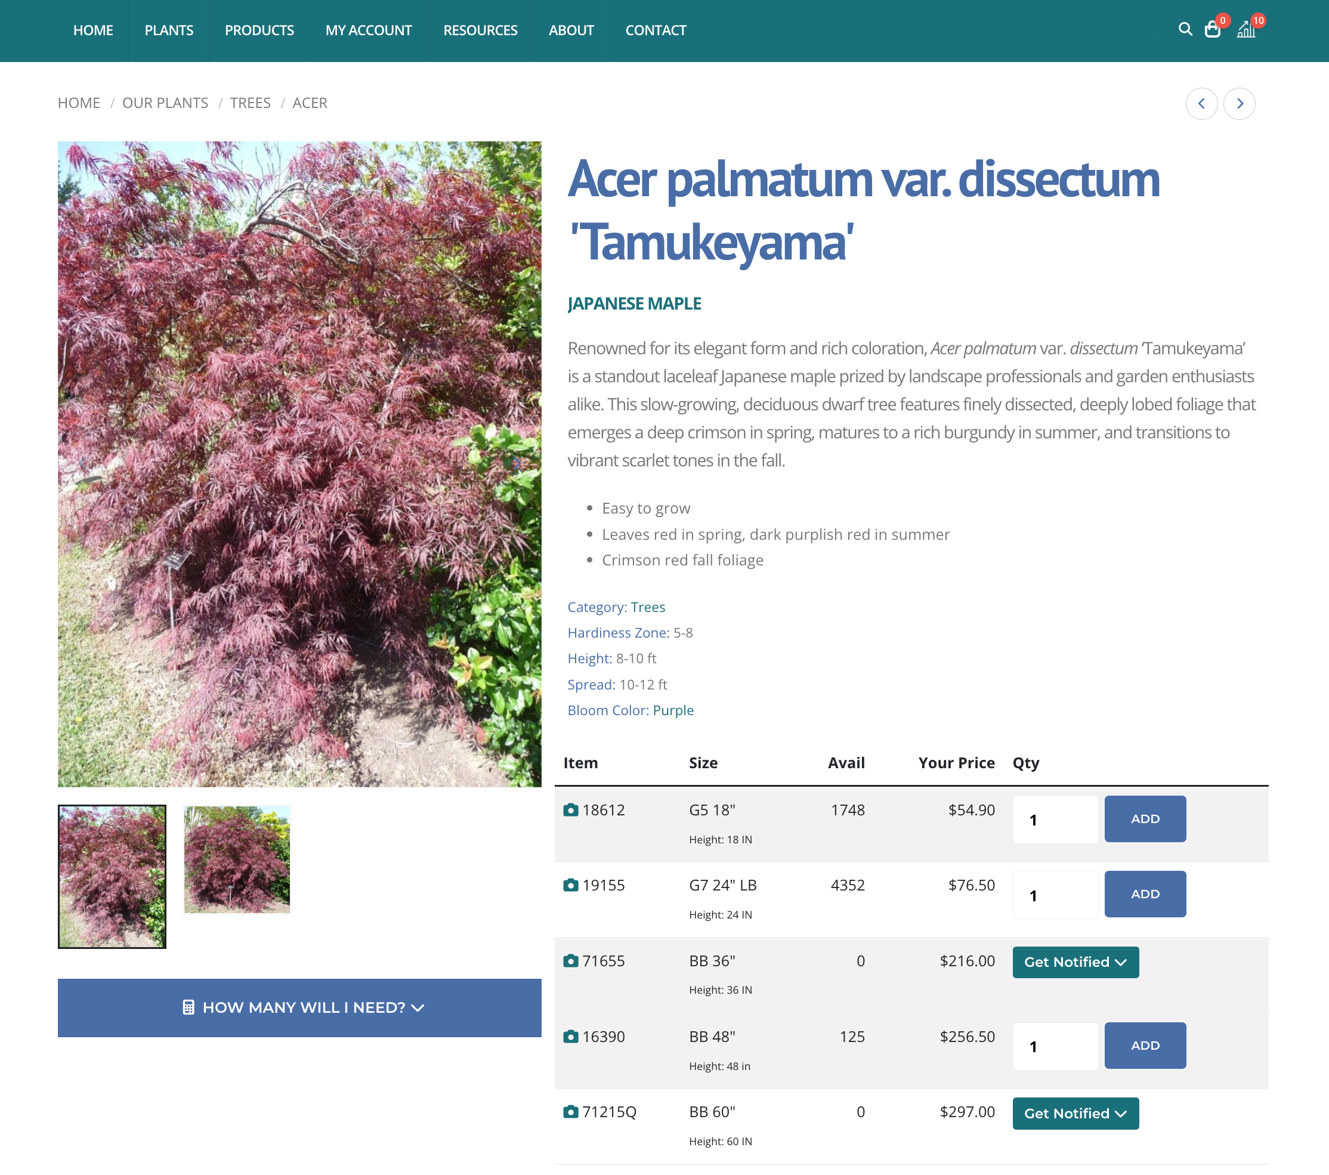
Simplifying Current Crop Photo Requests

Slide 7
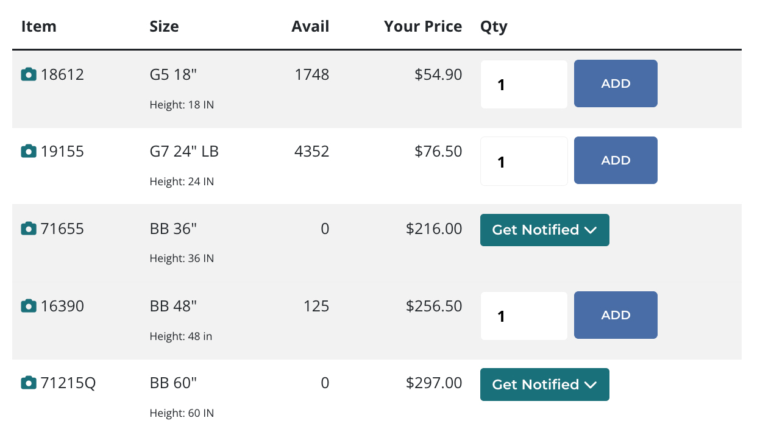
Simplifying Current Crop Photo Requests

Slide 8
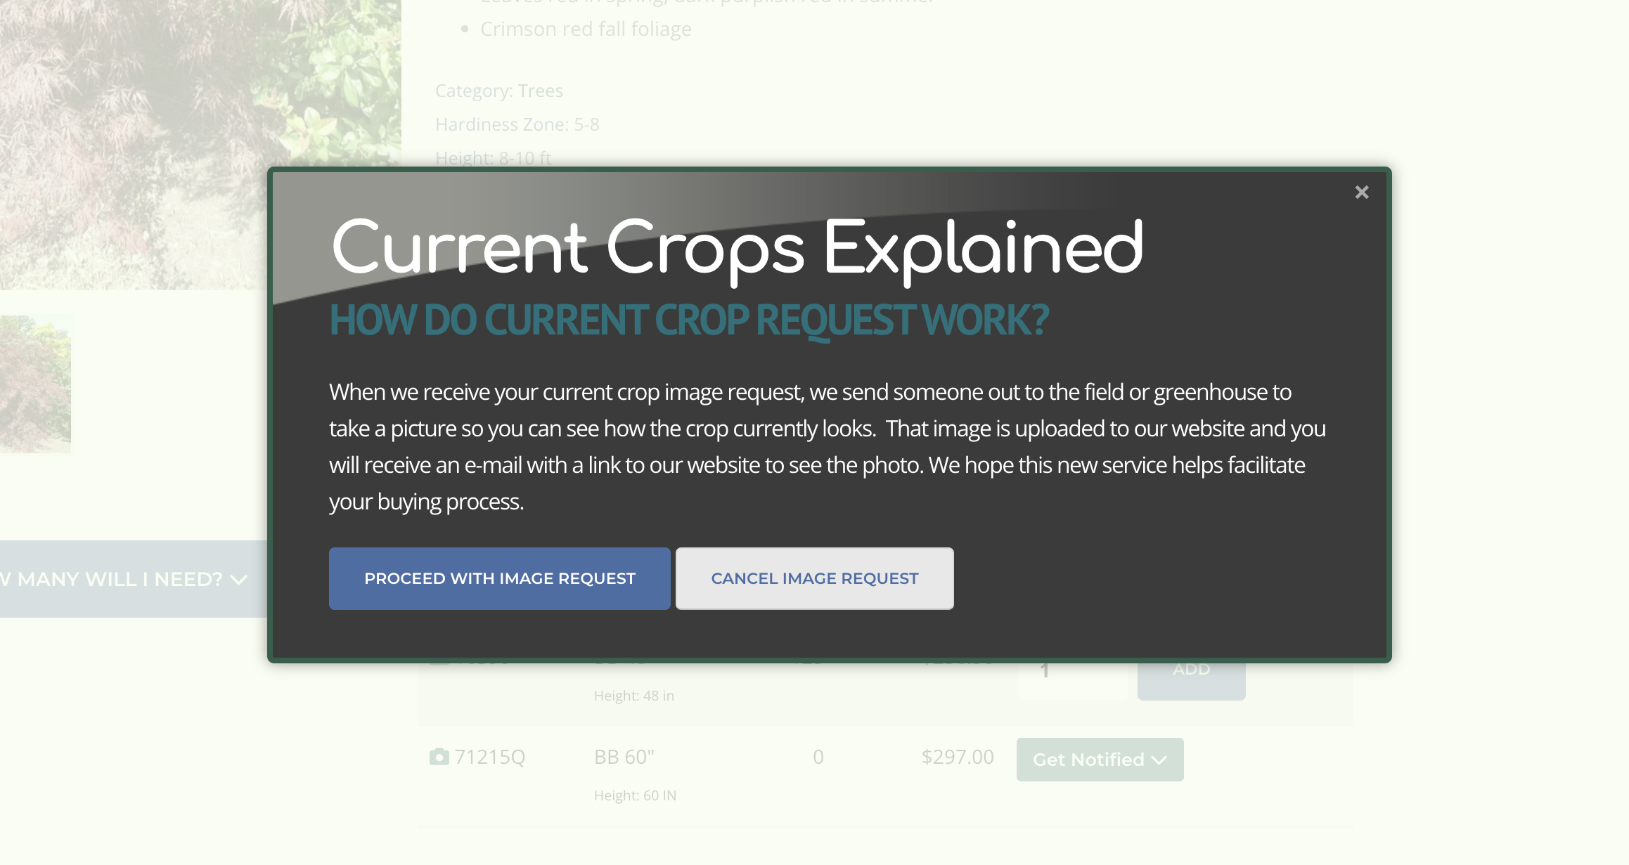
Simplifying Current Crop Photo Requests

Slide 9
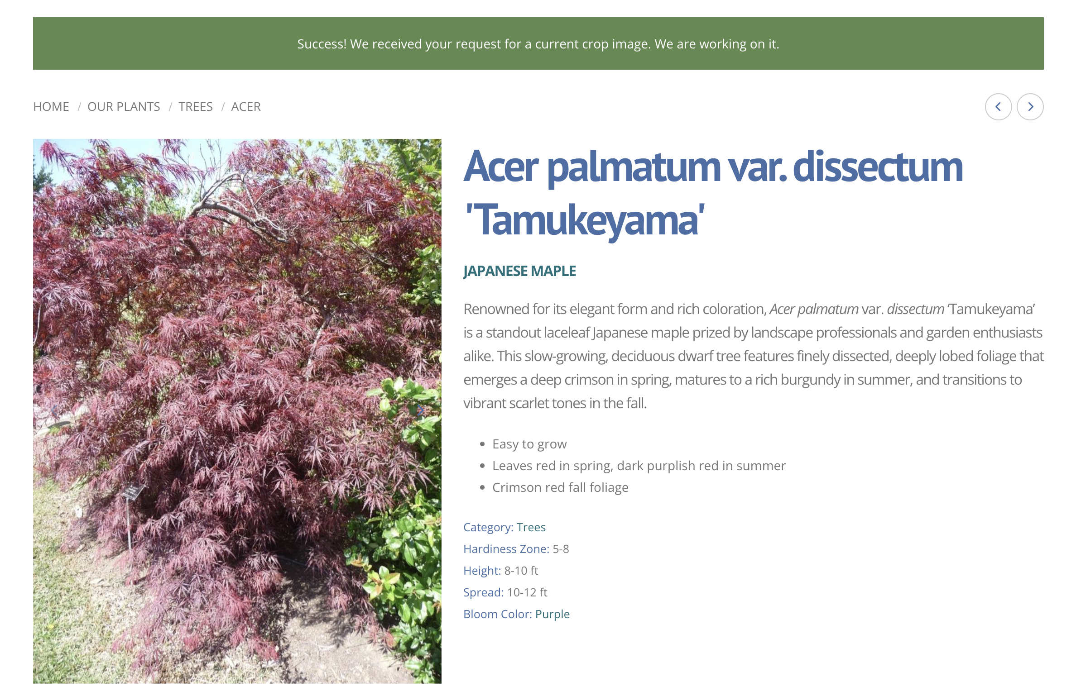
Simplifying Current Crop Photo Requests

Slide 10
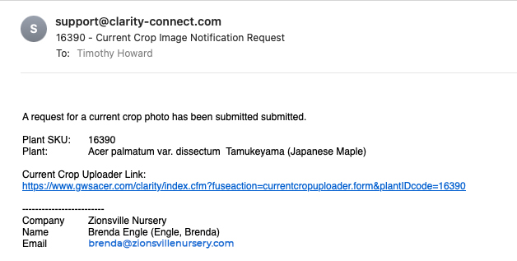
Simplifying Current Crop Photo Requests

Slide 11
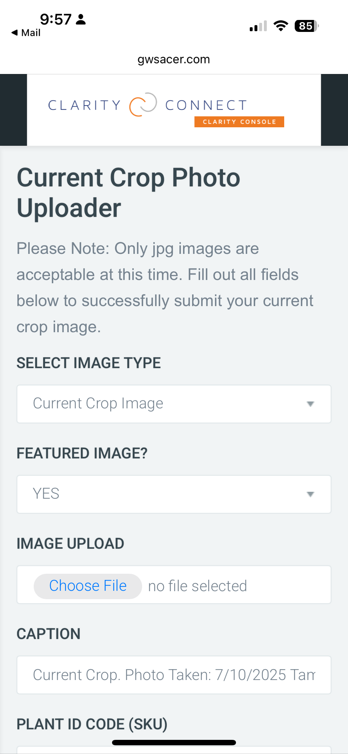
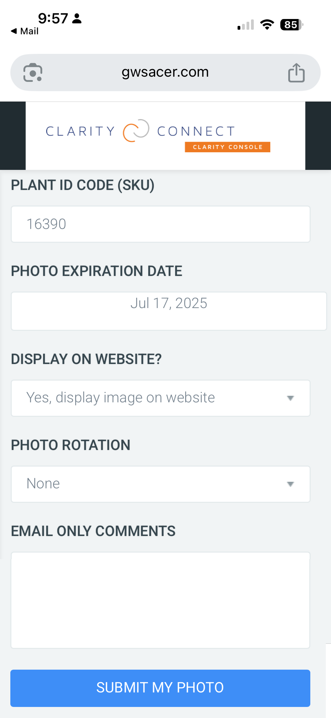
Simplifying Current Crop Photo Requests

Slide 12
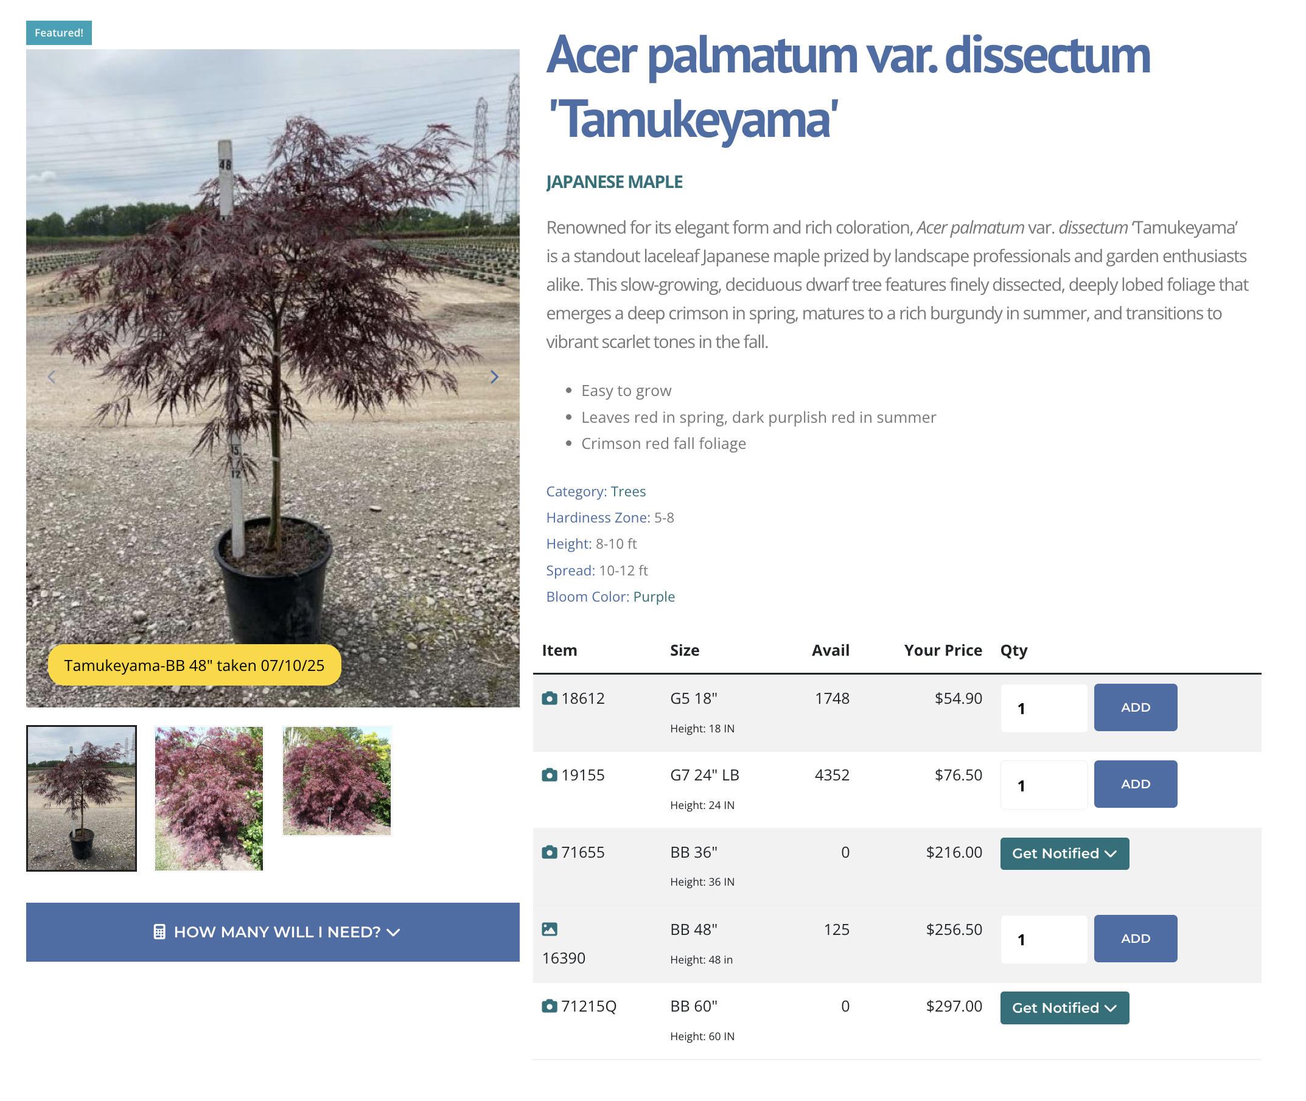
Simplifying Current Crop Photo Requests

Slide 13
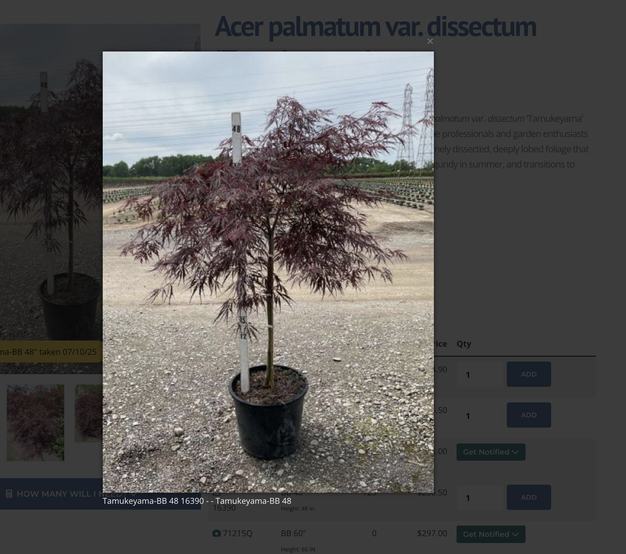
Simplifying Current Crop Photo Requests

Slide 14
Limit Overselling
An ounce of prevention is worth a pound of cure.

Slide 15

If you have it, you should sell it. If you don’t have it, don’t sell it, unless you want to irritate your customers.
Thanks, Captain Obvious!

Slide 16












Synchronize Inventory To Your Website
ORACLE NetSuite
Starcom
Microsoft NAV
Proprietary System
Quickbooks
Advance Grower Software (AGS)
PICAS
VMX
Plantiful
Proprietary System
Microsoft NAV
QuickBooks
Counterpoint

Slide 17
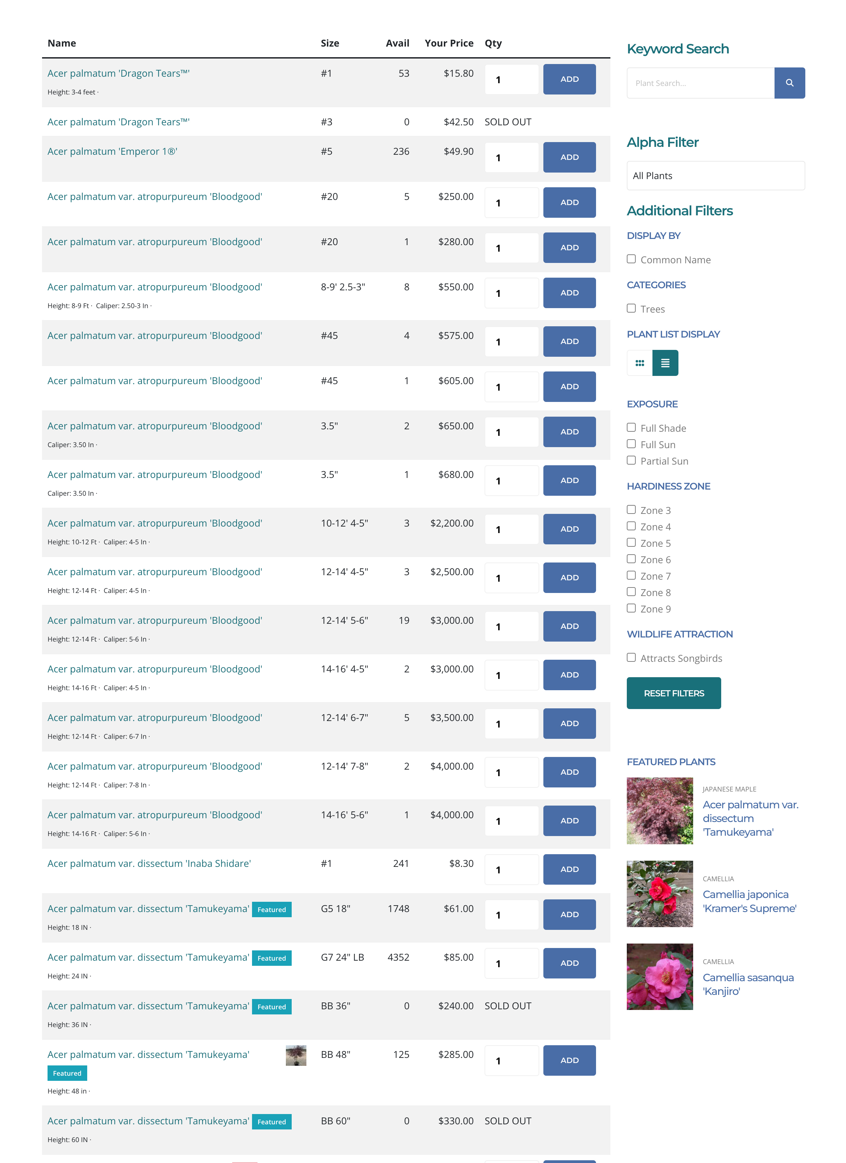
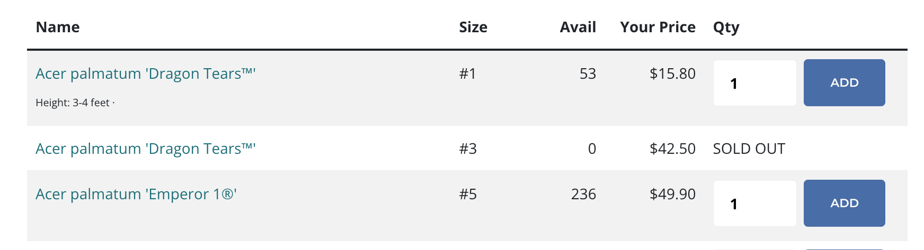
Limit Overselling Plants with proper inventory and automatic ‘smart’ substitutions

Slide 18
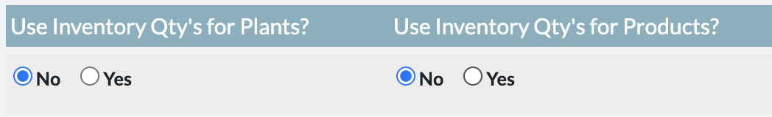
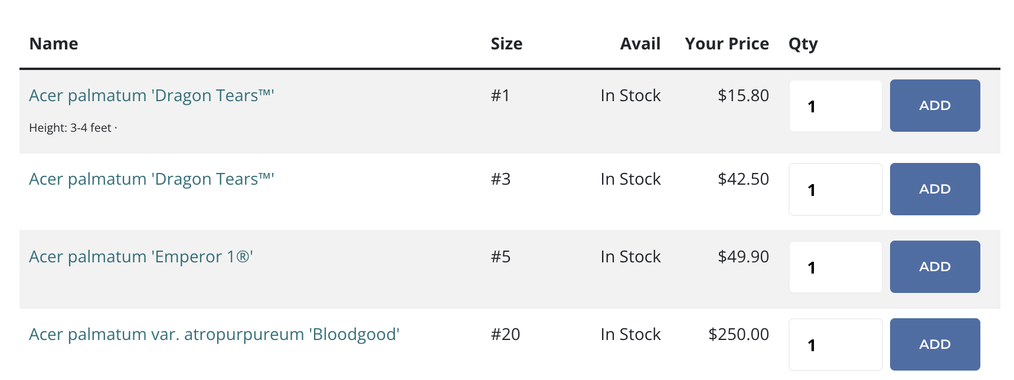
Limit Overselling Plants
Flexible Inventory Handling
  Specific Quantities
  Avail, Not Avail.

Slide 19
Limit Overselling Plants

Slide 20
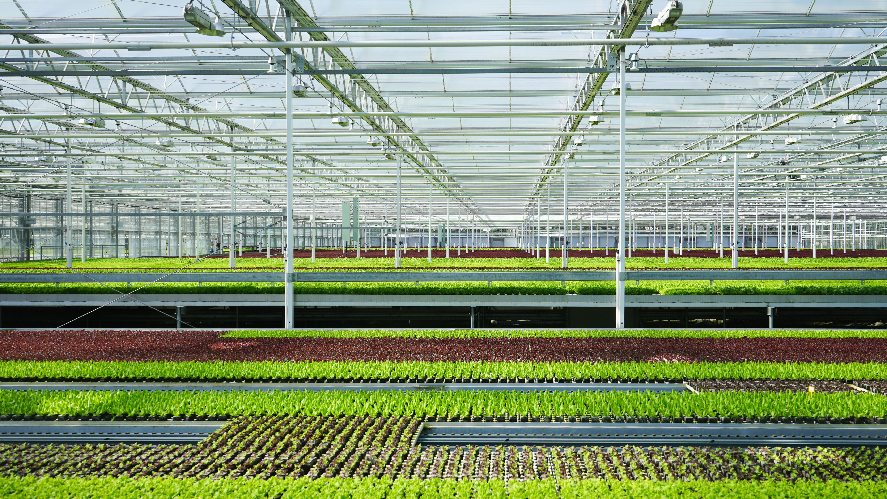
Automatic, Smart Plant Substitutions

Slide 21
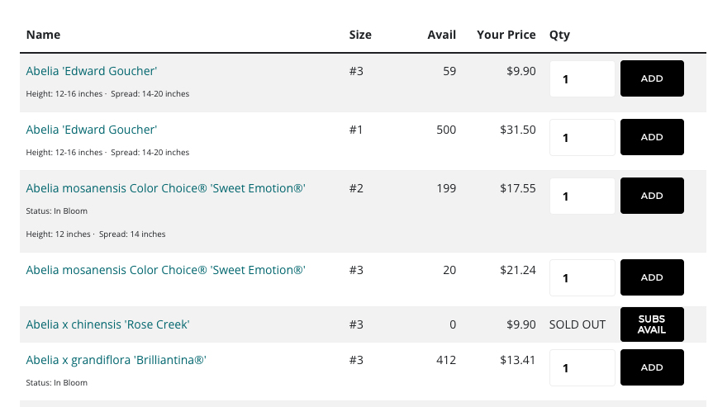

Slide 22
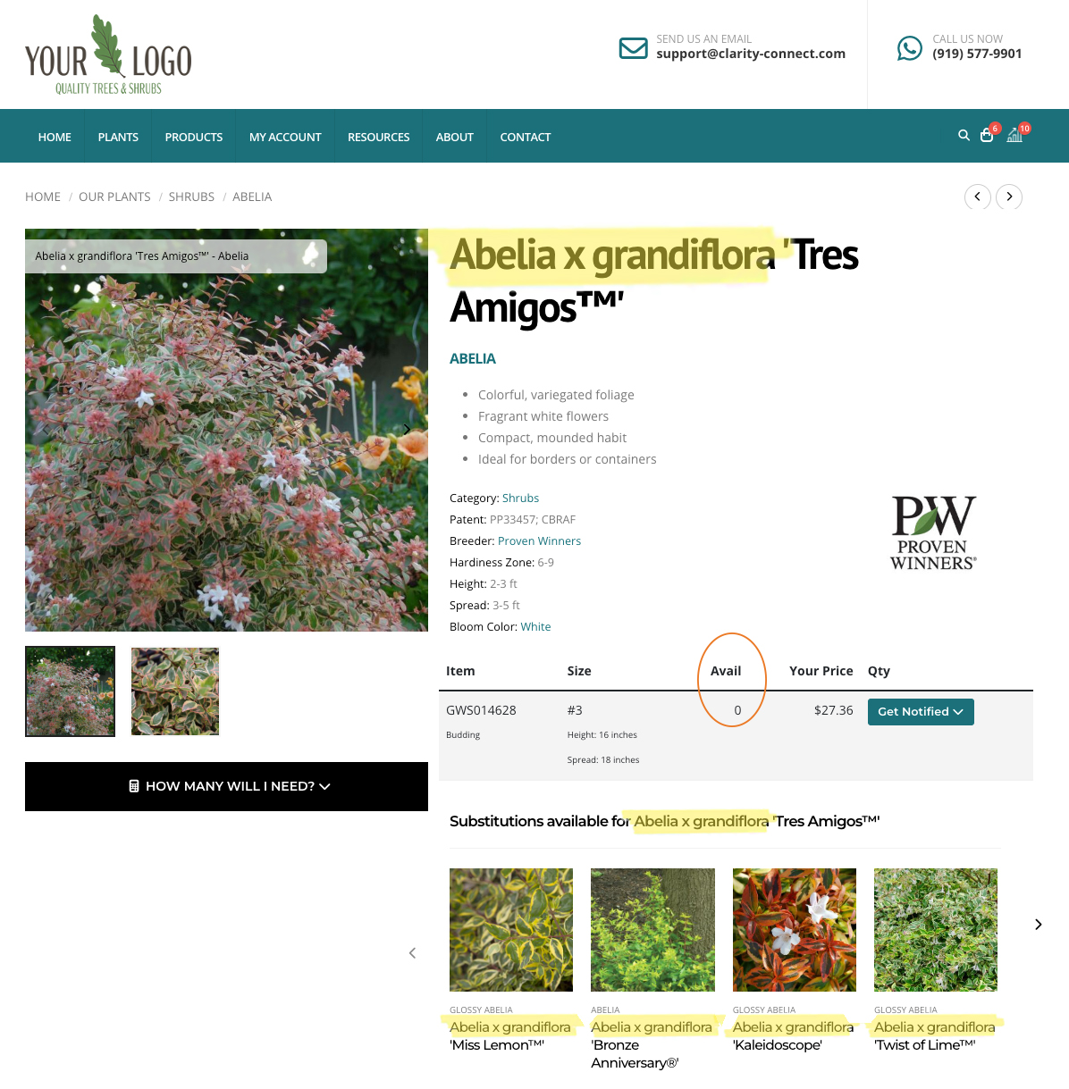
First Selection Level:
Genus + Species

Slide 23
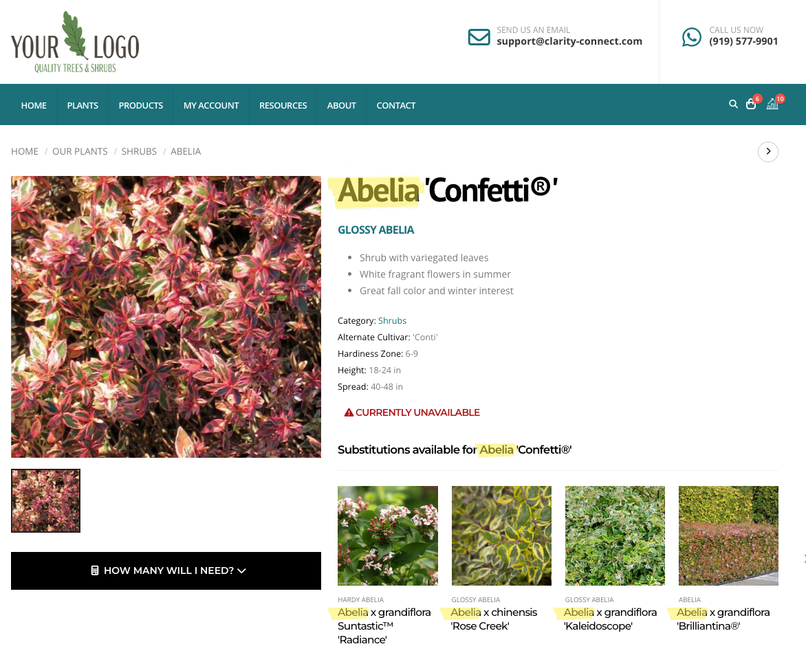
2nd Selection Level: Genus

Slide 24
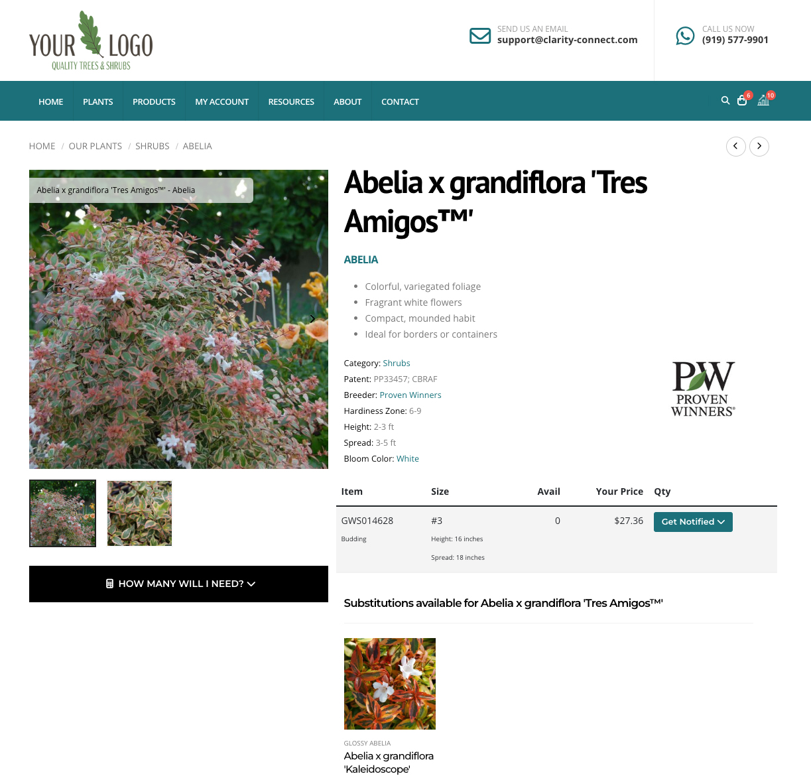
Manual Override:
Select One or More Specific Plants

Slide 25
Sending inventory updates;
Providing Customer Specific Price Lists

Slide 26
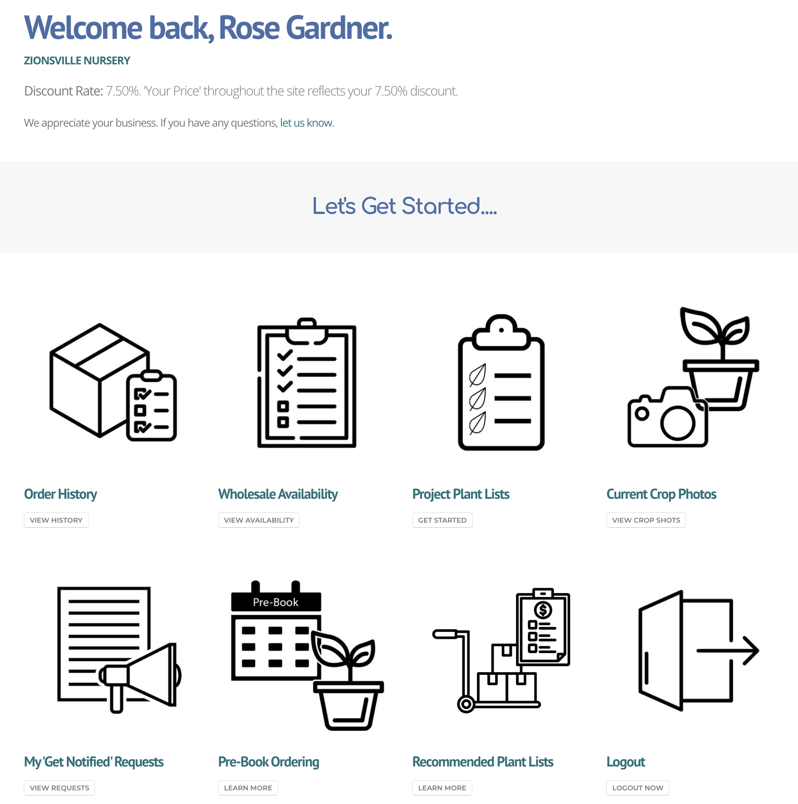

Automatic, Customer-Specific Pricing

Slide 27
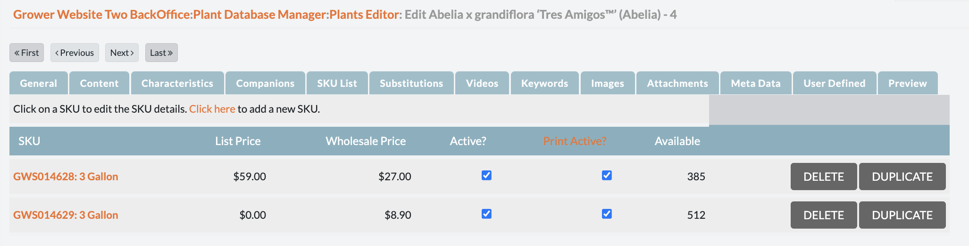
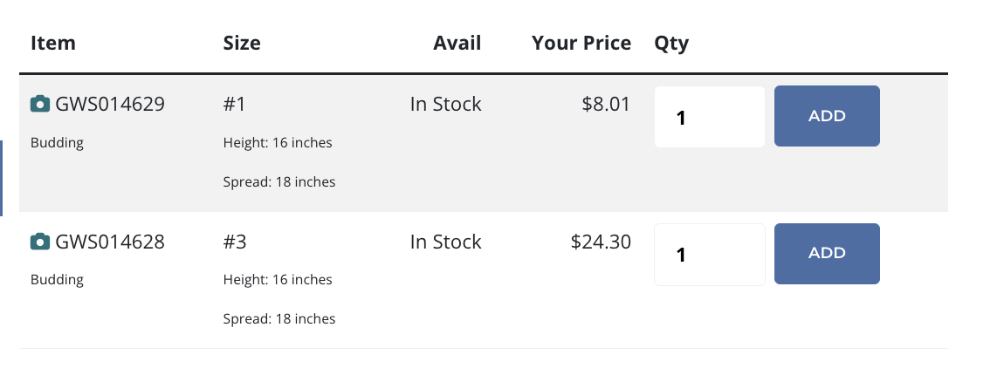
Standard Wholesale Pricing
Customer-Specific, Calculated Pricing

Slide 28
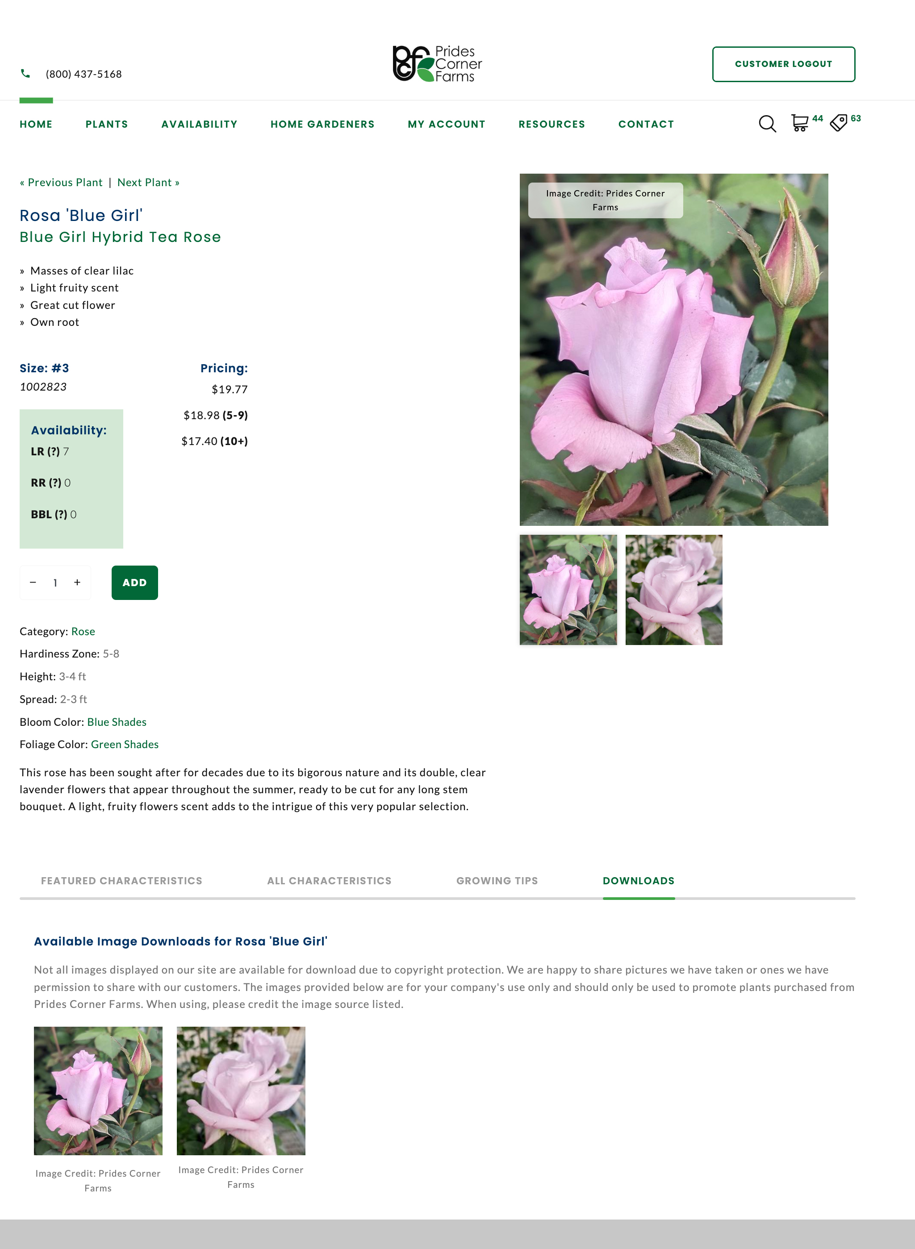
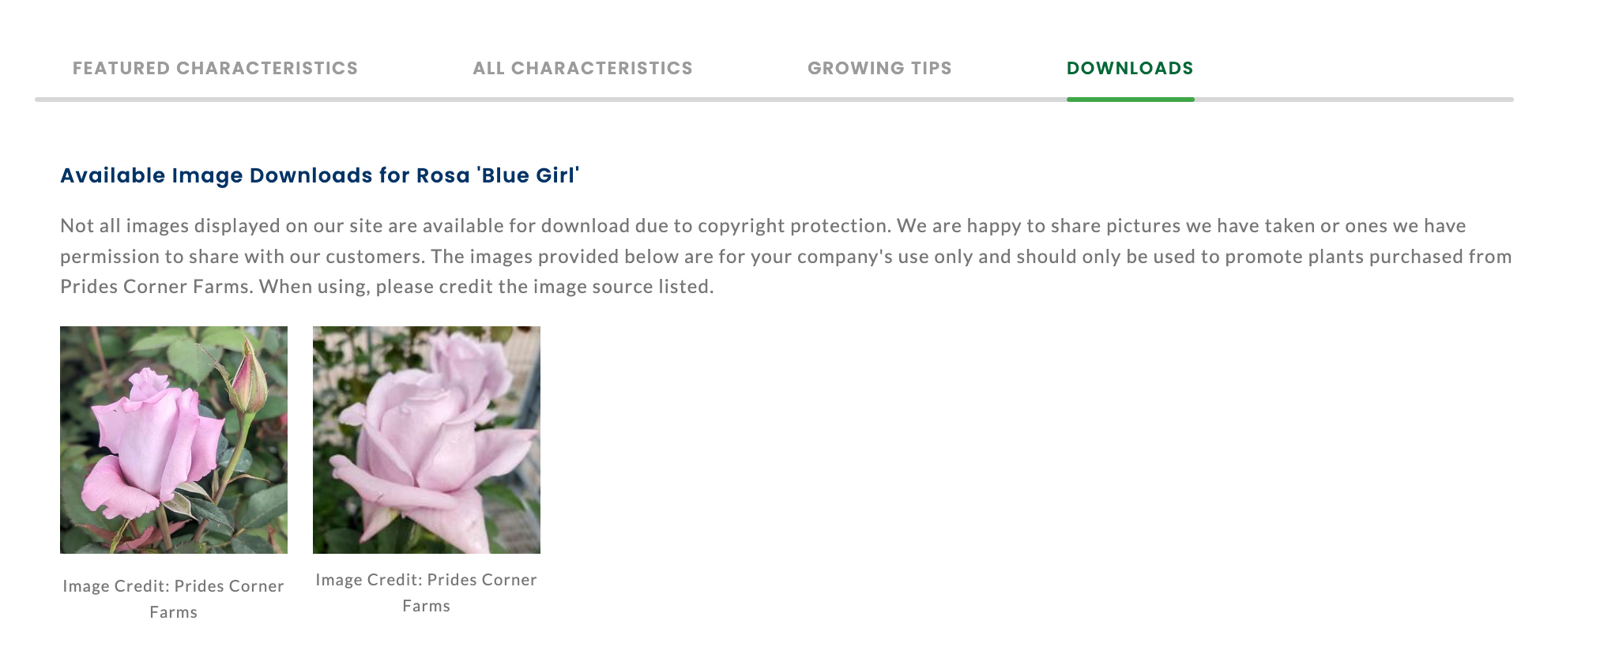
Providing Plant Marketing Images

Slide 29

Handholding New Buyers

Slide 30

A Win-Win for You and Your Customers
Recommended Orders
Create a list name
Assign various plant sizes and quantities
Customers add it to their cart
Cart can be modified before it’s submitted as an order
Notes:
Recommended Orders is new functionality we developed based on requests from growers that sell to Garden Centers. Growers can create a variety of different recommended orders to help IGC buyers place orders.

Slide 31
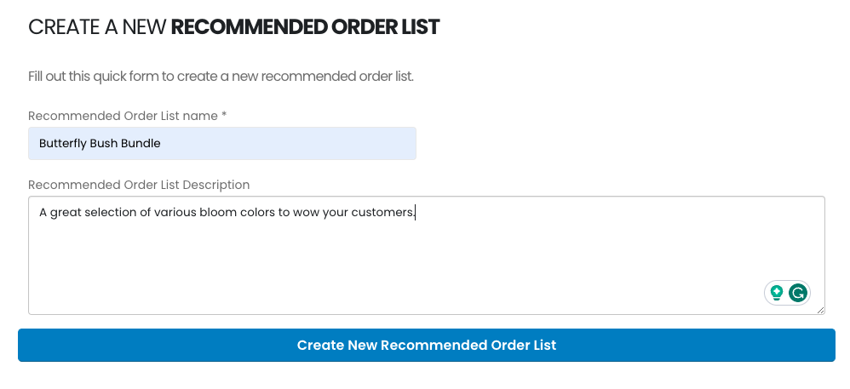

Recommended Orders
Create a LIST NAME
Notes:
For example, you might want a ‘$5,000 shade perennial recommended order’ or a ‘Butterfly Bush Bundle’.

Slide 32
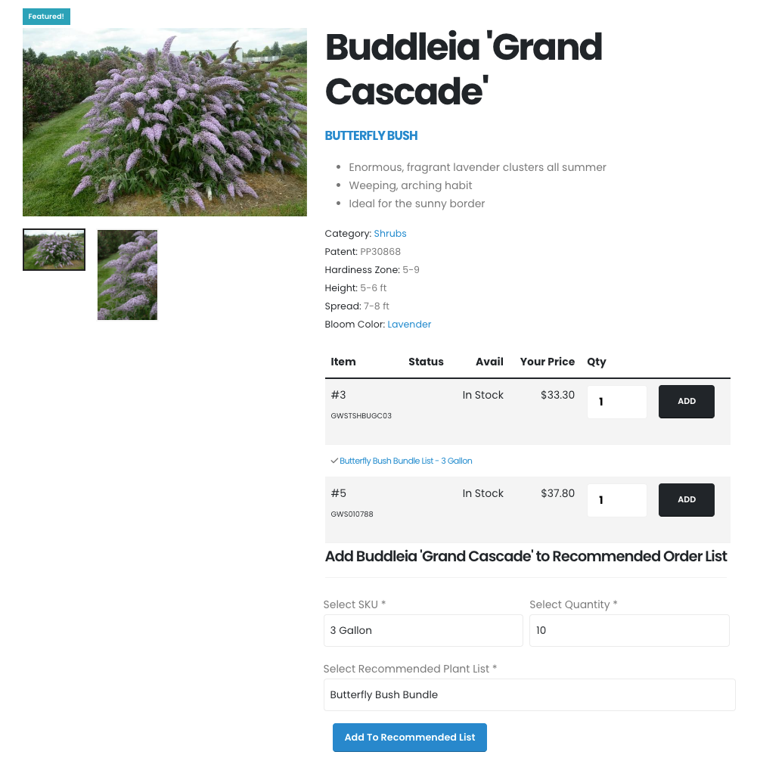

Recommended Orders
Assign various plant sizes and quantities
Notes:
Your authorized staff will be able to assign the appropriate plants’ sizes and quantities to each recommended order.

Slide 33
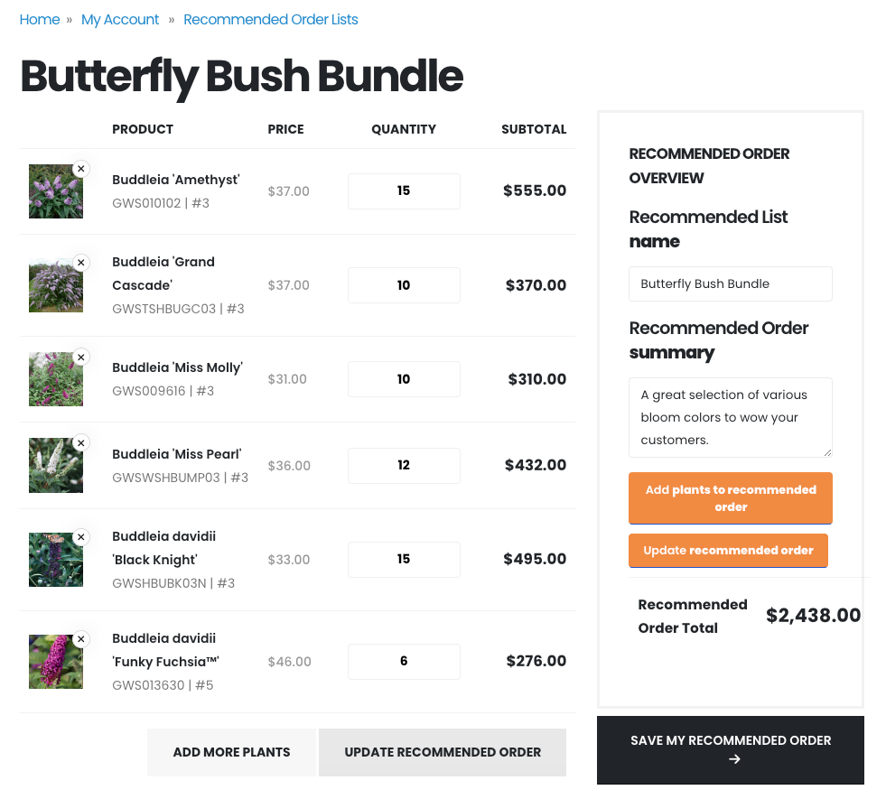

Recommended Orders
Customers add it to their cart
Notes:
Your customers will be able to access Recommended Orders and make any needed changes to plant selection and quantities before adding it to their order.

Slide 34
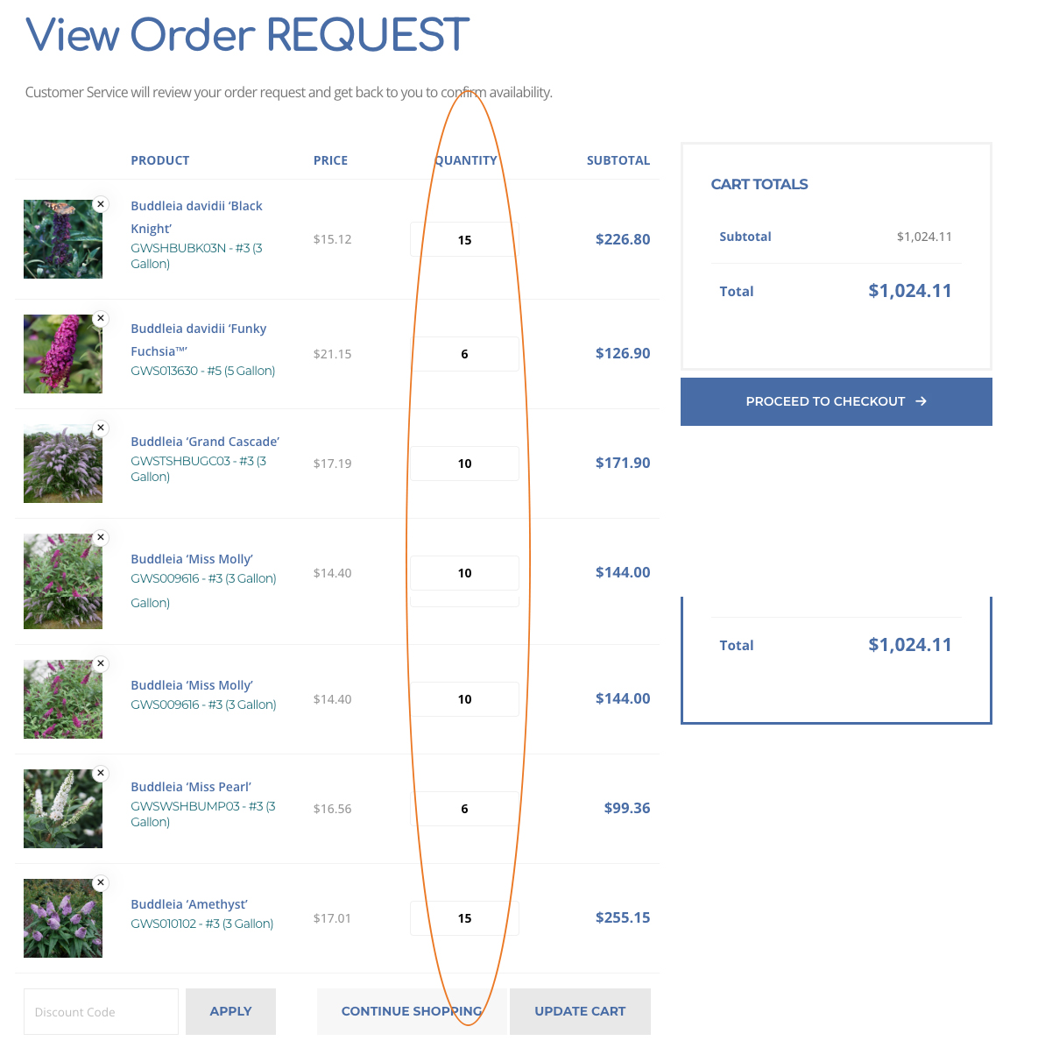
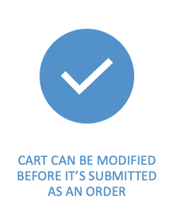
Customer can change quantities or delete from the order if needed.
Recommended Orders
Notes:
Your customers will be able to access Recommended Orders and make any needed changes to plant selection and quantities before adding it to their order.

Slide 35
When will that be back in stock?

Slide 36
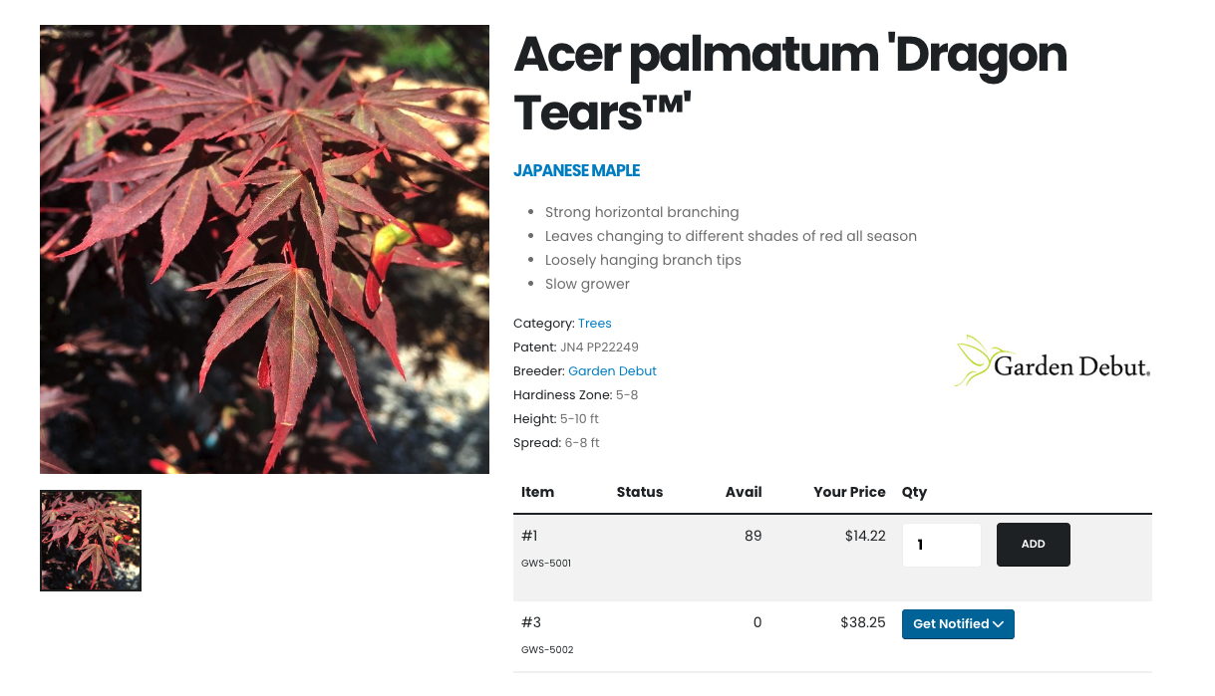

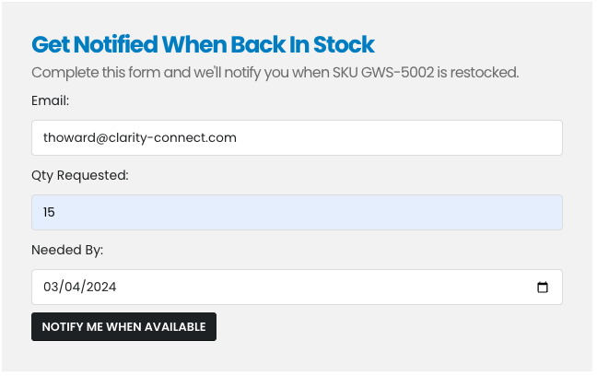
In-Stock Notifications
Customers can request to be notified when a specific plant variety and size (SKU) is back in stock
Enter a desired quantity and
date needed
Notes:
When an item is out of stock, your customers can submit a request to be notified when the plant is back in stock. To help you plan, their request includes the quantity they want and the date needed.

Slide 37
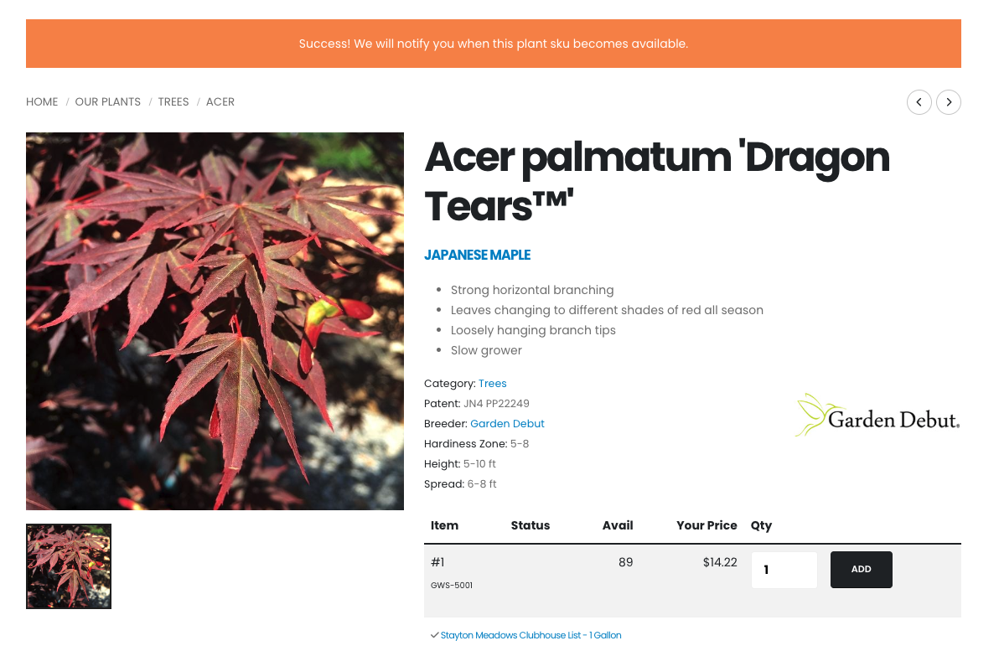
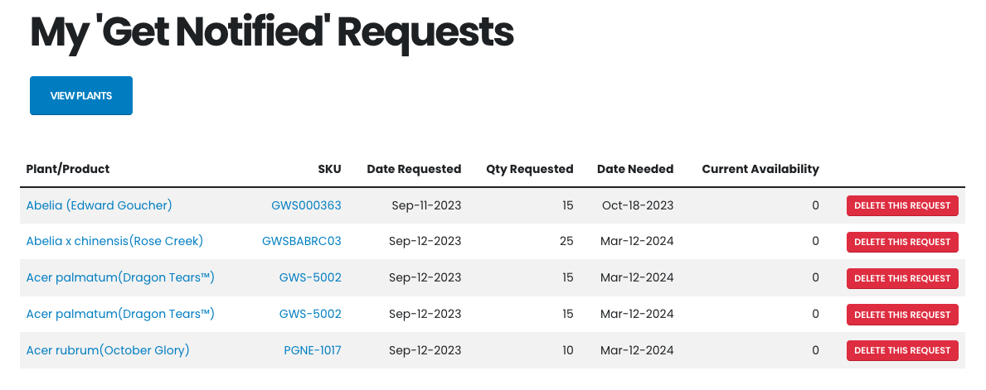
In-Stock Notifications
On-screen success message after completing a request
Customers can view all their open requests
Notes:
Your customers receive a ‘success’ notification and will have the option to see all their pending requests.

Slide 38
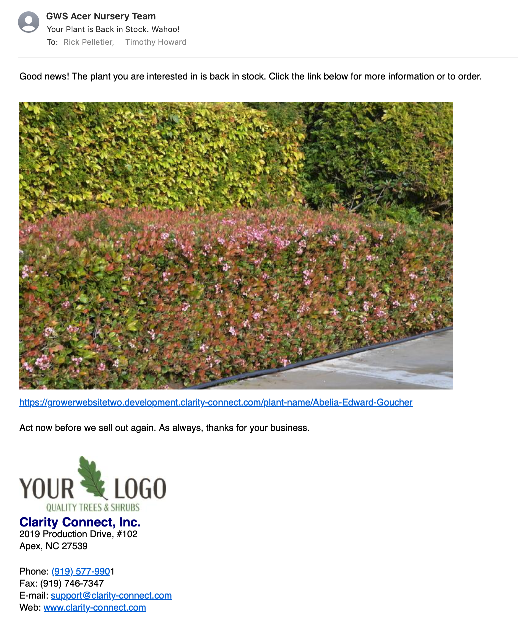
Plant is Back in Stock!
Email notification with link to plant page.

Slide 39

What goes well together?

Slide 40

How can your sales team be rainmakers?
Develop Programs
  Native Plants
  Fall Trees and Shrubs
  Hedges / Privacy Screening
  Water Wise Plants
Develop/Improve Relationships with Current Customers
Review Sales History to Identify Opportunities
Push Varieties with Excess Inventory
Resolve Problems
Prospecting & Networking
Call on New Customers

Slide 41
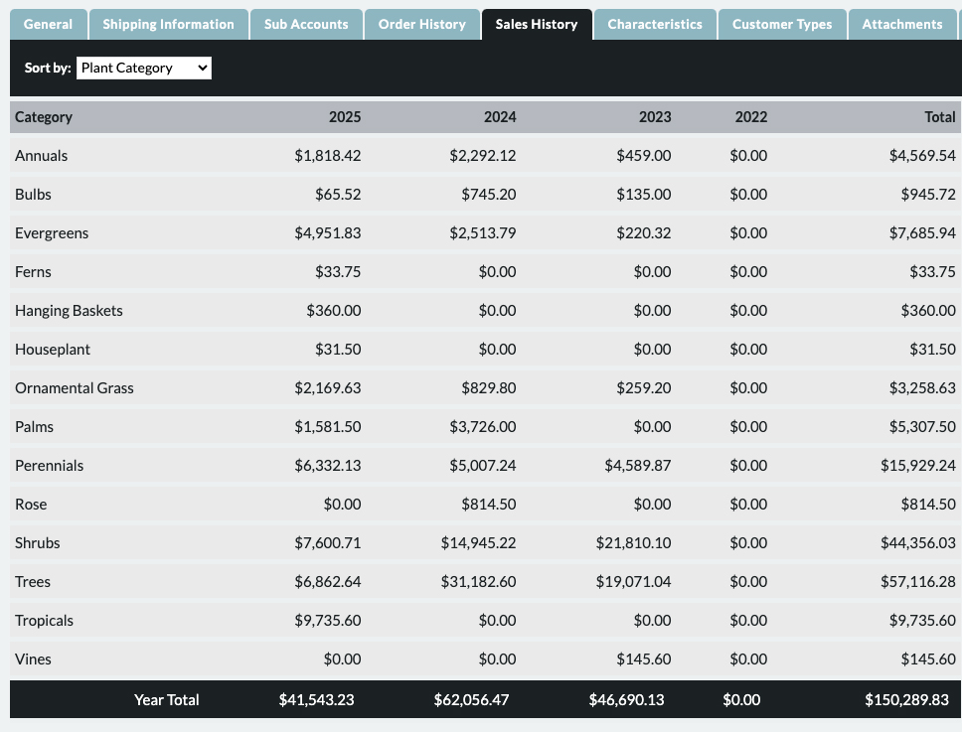
Review Sales History to Identify Opportunities

Slide 42
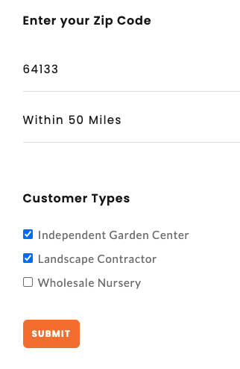
Where to Buy
Website Functionality

Slide 43
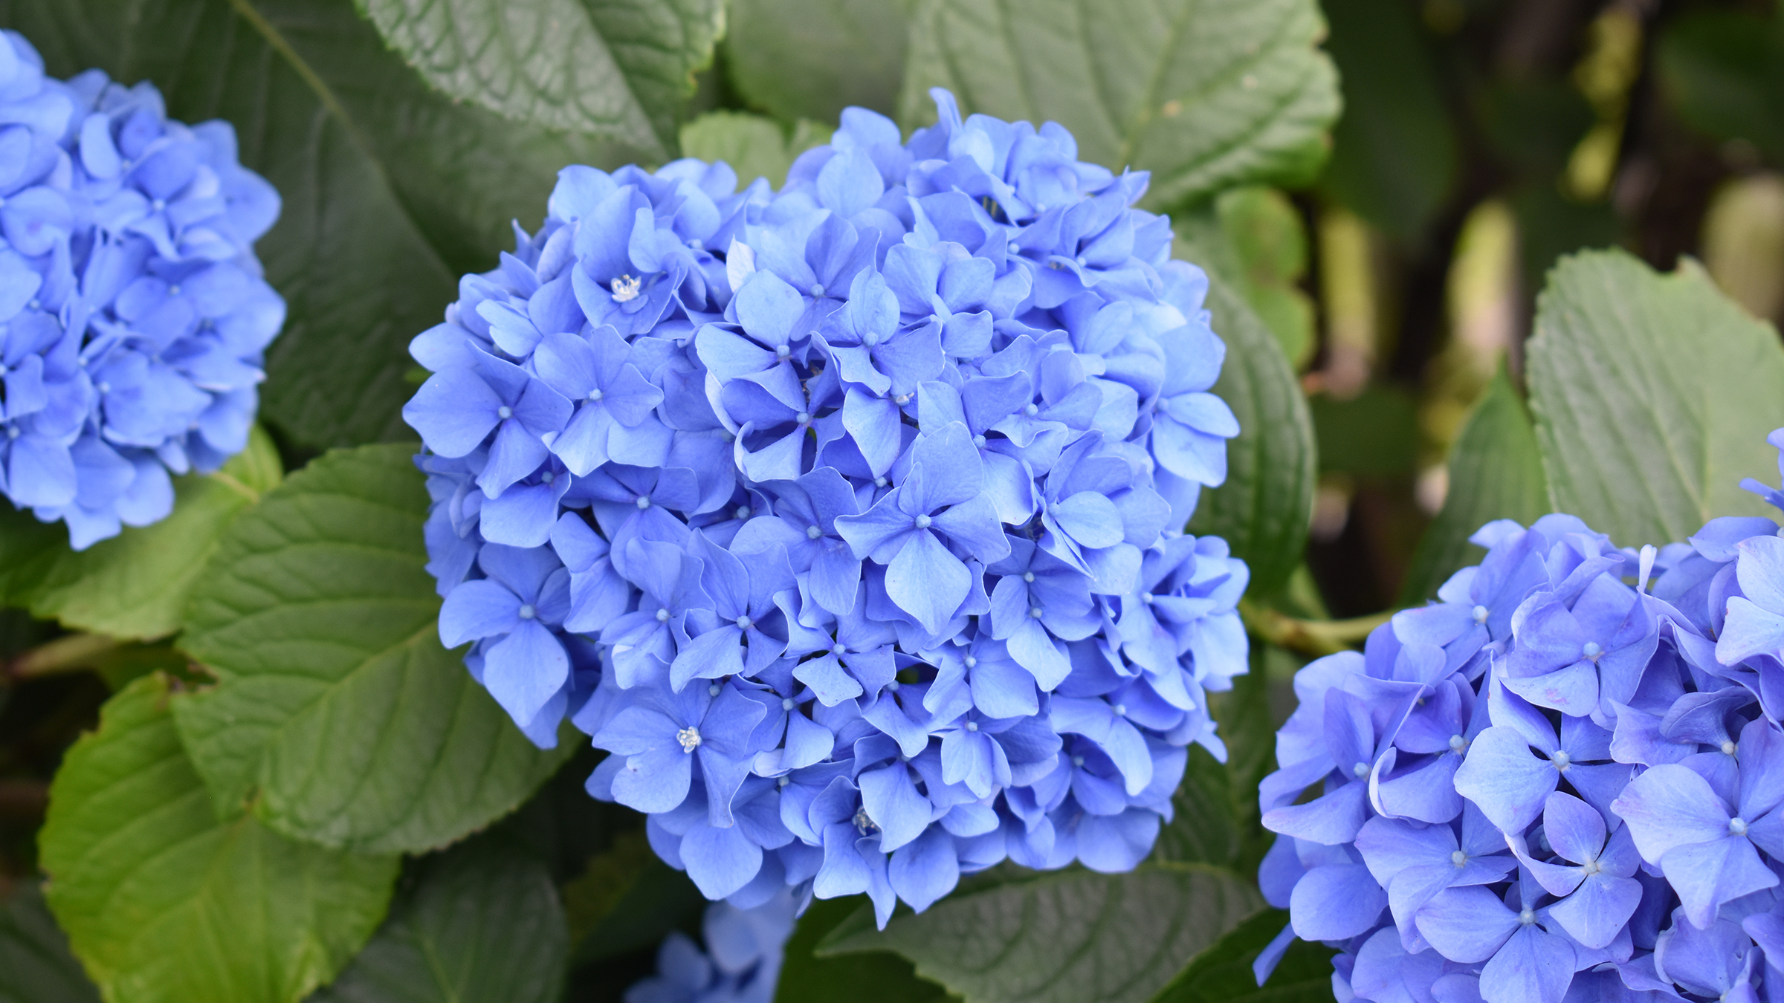

Questions?
Booth #2908

Slide 44

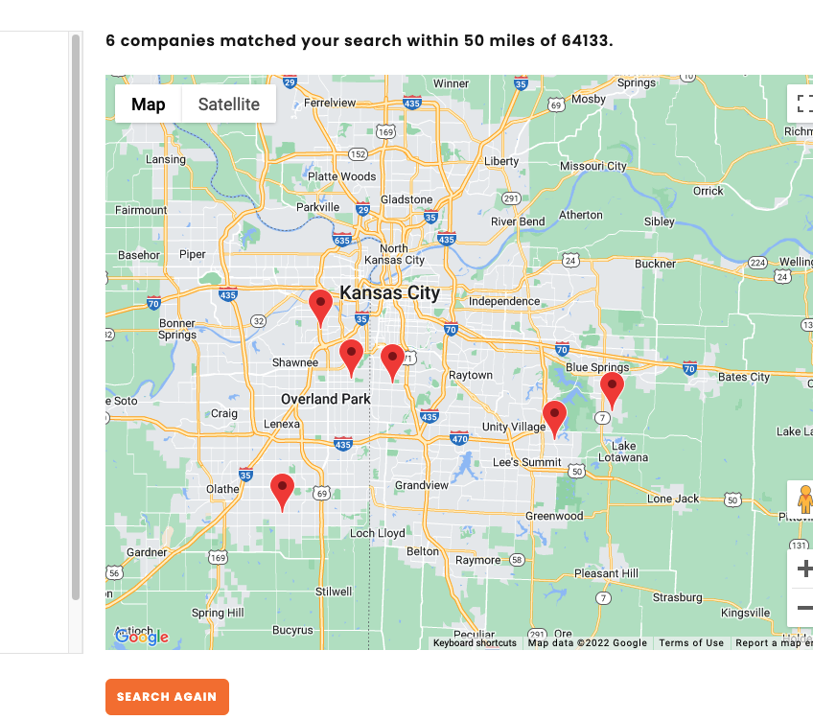
Where to Buy Results
Website Functionality

Slide 45
Low Value
High Value
High Time
High Time / Low Value Add
High Time / High Value Add
Low Time
Low Time / Low Value Add
Low Time / High Value Add

Slide 46

Making it Easier for Your Customers to Buy
Extensive Plant Library
Integration with inventory
Wholesale Pricing & functionality Post Login
Current Crop Photos
Project Plant Lists

Slide 47
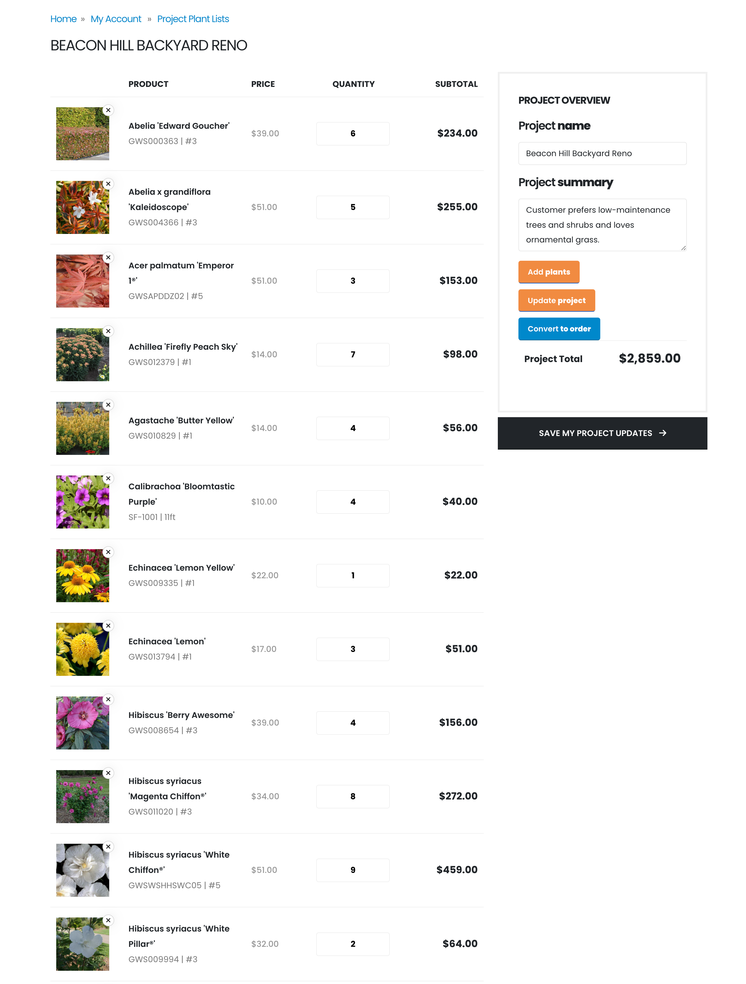

Project Plant Lists
Great for your Landscaping Customers
Helps close more business
Differentiates you from your competitors

Slide 48
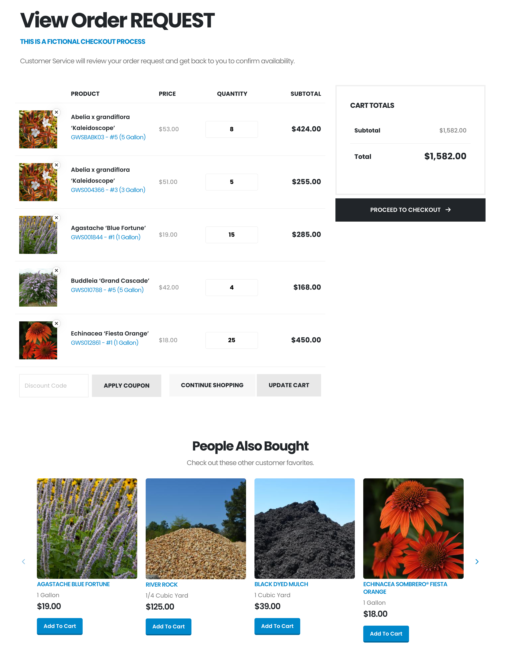

Seeing is Believing…
Let us show you
Functionality built to help you sell more plants, more profitably
Easy management of your website with our Clarity Console™ Content Management tools
Quick payback on your website investment

